Slide 1
The ZONES of Regulation®
Tiffany Schuette – School Counselor
New Holstein Elementary School
Notes:
How it started

Slide 2
What are The ZONES of Regulation®?
The ZONES is a concept designed by Leah Kuypers, licensed occupational therapist, to help a student gain skills in the area of self-regulation.
Self-regulation can go by many names, such as self-control, self-management, and impulse control. It is defined as the best state of alertness of both the body and emotions for the specific situation.
For example, when a student plays on the playground or in a competitive game, it is beneficial to have a higher state of alertness. However, that same state would not be appropriate in the library.

Slide 3
What are The ZONES of Regulation®?
The ZONES are designed to help the students recognize when they are in different zones as well as learn how to use strategies to change or stay in the zone they are in.
In addition to addressing self-regulation, the students have an increased vocabulary of emotional terms, skills in reading other people’s facial expressions, perspective about how others see and react to their behavior, insight into events that trigger their behavior, calming and alerting strategies, and problem solving skills.

Slide 4
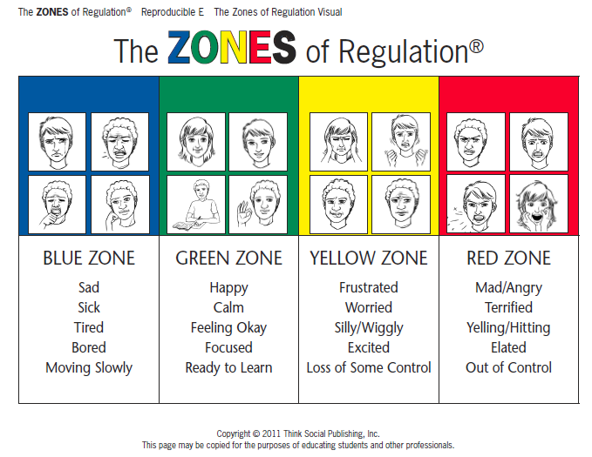
Notes:
How it was described in the classroom lesson

Slide 5
How are the ZONES useful?
A critical aspect of the Zones is that all team members know and understand The ZONES language.
This creates a comfortable and supportive environment for the student to practice his or her self-regulation skills.

Slide 6
How are the ZONES useful?
You can support the student during this process by doing the following:
Use the language and talk about the concepts of The ZONES as they apply to you in a variety of environments.
Make comments aloud so the student understands it is natural that we all experience the different zones and use strategies to control (or regulate) ourselves. For example, “This is really frustrating me and making me go into the Yellow Zone. I need to use a tool to calm down. I will take some deep breaths.”

Slide 7
How are the ZONES useful?
Help the student gain awareness of his or her zones and feelings by pointing out your observations.
Talk about what zone is “expected” in the situation or how a zone may have been “unexpected.”
Share with the student how his or her behavior is affecting the zone you are in and how you feel.
Help the student become comfortable using the language to communicate his or her feelings and needs by encouraging the student to share his or her zone with you.
Show interest in learning about the student’s triggers and Zones tools. Ask the student if he or she wants reminders to use these tools and how you should present these reminders.
Make sure you frequently reinforce the student for being in the expected zone rather than only pointing out when his or her zone is unexpected.

Slide 8
There is no such thing as a bad ZONE.
It is important to note that everyone experiences all of the zones—the Red and Yellow Zones are not the “bad” or “naughty” zones.
This is different than classroom behavior charts.
All of the zones are expected at one time or another.
The Zones of Regulation is intended to be neutral and not communicate judgment.

Slide 9
Implementing The ZONES School-wide
Step 1 – Get a team together and Purchase Zones of Regulation Book By Leah M. Kuypers & Michelle Garcia Winner (Amazon.com)
  Our team consisted of three individuals: Occupational Therapist, Speech and Language Pathologist & School Counselor.
Step 2 – Get approval from administration
Step 3 – Plan to present about the Zones to the staff – use this PowerPoint if you want.
Step 4 – Plan the student presentation with your team
Step 5 – Look at your team’s schedules and come up with times that will work to go to the individual classrooms to present.
Step 6 – Present the Zones to the staff. Explain the Zones of Regulation and schedule a time that will work for your team and the teachers for the student presentation.
Step 7 – After presentation, share Zones Documents (from CD-Rom) on Google Drive and send home parent packet.
Step 8 – Administer survey via Google to get staff feedback.
Notes:
Year One Implementation

Slide 10
Implementing The ZONES School-wide (continued)
Use The ZONES language school-wide and encourage students to be aware of what Zone they are in so they can self-regulate their reactions and behaviors.
Once they are aware of what Zone they are in, you can help them move to the Green Zone (happy, calm, ready to learn etc.)
Post the Zones chart
Upper grades make their own toolbox
Lower grades (K-2) Teachers may choose to have a toolbox posted in which they can add strategies

Slide 11
ZONES Lesson Plans and Videos
How to access all materials (& Lesson Plans!):
Google: New Holstein School District
Click on Main Menu (top right corner)
Click on Staff Listing
Under Last Name Contains: enter Schuette
Click on Web site
On the upper right, scroll over faculty menu and click on WSCA Conference Attendees
Any Questions? tschuette@nhsd.k12.wi.us

Slide 12
ZONES Lesson Plans - Introductory
ALL LESSON PLANS ARE ON MY WEBSITE
Go over Zones Chart
Explain different strategies that can be used to move to the Green Zone.
Be sure to always mention that there is no such thing as a bad zone.
Watch YouTube Videos describing each Zone
Fill out Toolbox (Grades 2-5)

Slide 13
ZONES Lesson Plans and Videos
  Here is a video on what it looks like to be in the Blue Zone (Barbie crying and upset): http://www.youtube.com/watch?v=a5ze5PfDEzI&index=2&list=PL87B22B04EC463D3B
  Here is a video on what it looks like to be in the Green Zone: (Finding Nemo: Just Keep Swimming): https://www.youtube.com/watch?v=sB6W2VAx2J8
  Here is a video on what it looks like to be in the Yellow Zone (Mike’s New Car): https://www.youtube.com/watch?v=zfC_GuHiP68
  Here is a video on what it looks like to be in the Red Zone (Lucy mad in Charlie Brown): http://www.youtube.com/watch?v=pq9hBEvFNlM&list=PLD7C6A74DFECE6B3F&index=1

Slide 14
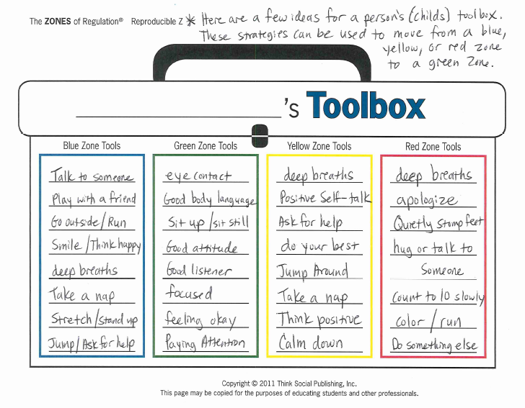

Slide 15
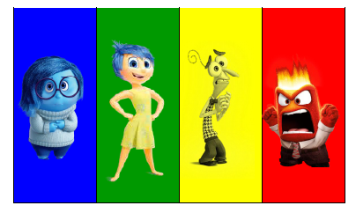
Other Tools and ZONES Visuals
Notes:
Visuals for Kids
*** Kindergarten student – Red Zone

Slide 16
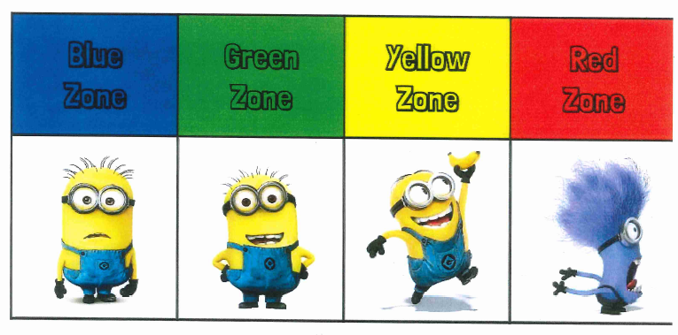
Other Tools and ZONES Visuals

Slide 17
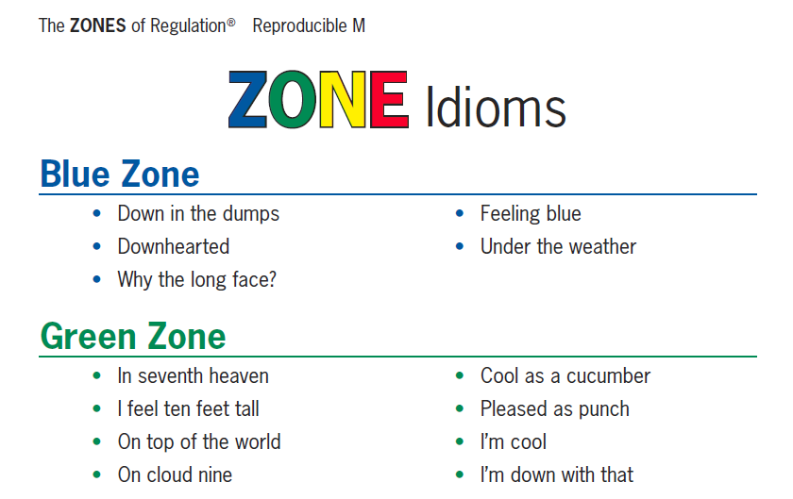
Other Tools and ZONES Visuals
Notes:
Parent Packet – Put into perspective for adults.

Slide 18
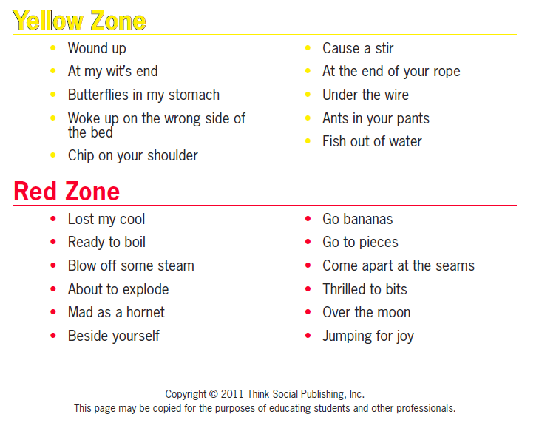
Other Tools and ZONES Visuals

Slide 19
Benefits to The ZONES at the Elementary School Level
LANGUAGE!!!! A common language for all staff to use with students.
  For example: A student comes to school in the morning and looks tired and is moving slowly. A teacher can say “You seem like you are in the Blue Zone.” The student recognizes they are in Blue Zone and use strategies to move to Green.
The Zones of Regulation are simple for kids to understand.
Kids know the different colors, recognize their feelings and use strategies to move to Green Zone (calm down or feel okay).
As a result students learn to self-regulate.
After the initial introductory lessons are administered the continuing implementation lessons are delivered.
Notes:
Note: Other than ready to learn in the green Zone we also want to be in the Green Zone for a health benefit.
Middle School has more stress and body changes. Emotions and relationships are more complex. In some of the Zones they may have to lave a larger set of tools. Middle School understands more on what they need to regulate and help them understand how their feelings impact their behavior and choices.

Slide 20
Additional ZONES Lessons
Year 1 - Introduced the Zones of Regulation
Year 2
  4K/5K Lessons Introduce Zones
  Each grade in 1st through 5th have different lessons that focus more on using tools and strategies to self-regulate.
Continuing implementation
  The Year 2 lessons are designed to use year after year to provide further education for the Zones in Grades 4K through 5th Grade.

Slide 21
Lesson Plans – Derived from the ZONES of Regulation Book by Leah Kuypers
4K/5K Zones Introductory Lessons 5k – 2nd Lesson on self-regulation tools | 1st Grade Zones Idiom Game (Lesson #7) Zones Bingo (Lesson #2)
2nd Grade Me in My Zones Packet (Lesson #6) Stop, Opt, and Go (Lesson #17) Zones toolbox review (Lesson #13, Reproducible AA & BB) | 3rd Grade Yellow Zone (Lesson # 14) Zones toolbox review (Lesson #13, Reproducible Z)
4th Grade Inner Critic vs. Inner Coach (Lesson #12) Zones toolbox review (Lesson #13, Reproducible Z) | 5th Grade Calming Strategies and Tools Practice – with different stations (Lessons #10 & #11) Zones toolbox review (Lesson #13, Reproducible Z)
Notes:
Leah’s lessons in the Zones book are designed for individual or small group work.
I took her lessons and made them appropriate for whole group classroom instruction.

Slide 22
ZONES Lesson Plans – Continuing Implementation
4K/5K – Introductory Lesson – Same as year 1 Implementation
5K – booster lesson – Zones Check-In and Tools Exploration
1st Grade
  Zones Idiom Game
  Zones Bingo
2nd Grade
  Zones Toolbox (filled out as a class)
  STOP, OPT, & GO

Slide 23
ZONES Lesson Plans – Continuing Implementation
3rd, 4th, and 5th grade students filled out their own copy of the Zones Toolbox.
3rd Grade
  Yellow Zone Lesson and Role Plays
4th Grade
  Inner Coach vs Inner Critic
5th Grade
  Sensory Stations/Calming Strategies & Tools

Slide 24
ZONES – Individual Counseling
Use the Zones where applicable in individual counseling sessions
Examples:
  Kindergarten Student (See detailed examples on my website)

Slide 25
ZONES – Small Group Counseling
Kindergarten Respect Group
  Respect to friends and adults
Unexpected vs Expected behavior and when others have Comfortable or Uncomfortable thoughts about our behavior.
See example on my website

Slide 26
ZONES – Small Group Counseling
Ideas for Small Group Counseling
  Friendship/ Social Skills Group – Use Expected vs. Unexpected behavior and uncomfortable or good thoughts.
  Anger Management Group – Talk about the Red Zone and strategies that can be used to move to the Green Zone.
  Shyness or Bereavement or Divorce Group - Talk about the Blue Zone and strategies that can be used to move to the Green Zone.
  Focusing or Worry/Coping Skills Group - Talk about the Yellow Zone and strategies that can be used to move to the Green Zone.

Slide 27
ZONES of Regulation
School Climate – PBIS
Present to school board
Present to the Staff
Students have strategies and an understanding of the Zones
Staff have the Zones Language
Parent Packet – sent home with all students.

Slide 28
More Information on The ZONES
Zones of Regulation website: http://www.zonesofregulation.com/
Zones of Regulation Book and USB on Amazon.com

Slide 29
More Information on The ZONES
Zones of Regulation website – Mrs. Durantes Zones:
  http://mrsduranteszones.weebly.com/the-zones-of-regulation.html
YouTube – Has Zones of Regulation channels – one for each color Zone.
Zones of Regulation Apps by Selosoft, Inc.
  The Zones of Regulation
  The Zones of Regulation: Exploring Emotions

Slide 30
Contact Information/Questions?
Tiffany Schuette
Elementary School Counselor
New Holstein School District
(920) 898-4208
tschuette@nhsd.k12.wi.us
How to access all materials (& Lesson Plans!):
Google: New Holstein School District
Click on Main Menu (top right corner)
Click on Staff Listing
Under Last Name Contains: enter Schuette
Click on Web site
On the upper right, scroll over faculty menu and click on WSCA Conference Attendees
Any Questions? tschuette@nhsd.k12.wi.us

